Slide 1
BODY FLUIDS AND EDEMA
Prof. Shraddha Singh, K.G.M.U.

Slide 2
Daily Intake and Output of Water (ml/day)

Slide 5
INSENSIBLE WATER LOSS
Some of the water losses cannot be precisely regulated
For example, there is a continuous loss of water by evaporation from the respiratory tract and diffusion through the skin, which together account for about 700 ml/day of water loss under normal conditions.
This is termed insensible water loss because we are not consciously aware of it, even though it occurs continually in all living humans.

Slide 6
TOTAL BODY FLUID
60% of the body weight in man
50% of the body weight in woman
70-75% of the body weight in infants

Slide 7
BODY FLUID COMPARTMENTS
TOTAL BODY FLUID
60% of body weight in adult man, i.e, 42L in 70kg man
Extracellular fluid : 20% of body weight
TRANSCELLULAR FLUID
1-2 litres
INTRACELLULAR FLUID
40% of body weight, 28L
EXTRACELLULAR FLUID
20% of body weight, 14L
INTERSTITIAL FLUID
3/4th i.e, 11L
INTRAVASCULAR FLUID
1/4th i.e, 3L

Slide 8
Constituents of Extracellular and Intracellular Fluids

Slide 9
About 80 percent of the total osmolarity of the extracellular fluid is due to sodium and chloride ions
Almost half of the total osmolarity of the intracellular fluid is due to potassium ions and the remainder is divided among many other intracellular substances

Slide 12
MOLES AND OSMOLES
One osmole (osm) is equal to 1 mole (mol) (6.02 × 10²³) of solute particles.
A solution containing 1 mole of glucose in each litre has a concentration of 1 osm/L.
If a molecule dissociates into two ions such as NaCl (ionizing to give Cl⁻ and Na⁺), then a solution containing 1mol/L will have an osmolar concentration of 2osm/L.
Likewise, a solution that contains 1 mole of a molecule that dissociates into three ions, such as sodium sulfate (Na₂SO₄), will contain 3osm/L.
Thus, the term osmole refers to the number of osmotically active particles in a solution rather than to the molar concentration.

Slide 13
OSMOLALITY
OSMOLARITY
osmoles per litre of solution
osmoles per kilogram of water (solvent)

Slide 14
Effects of
isotonic (A),
hypertonic (B), and
hypotonic (C)
solutions
on cell volume

Slide 15
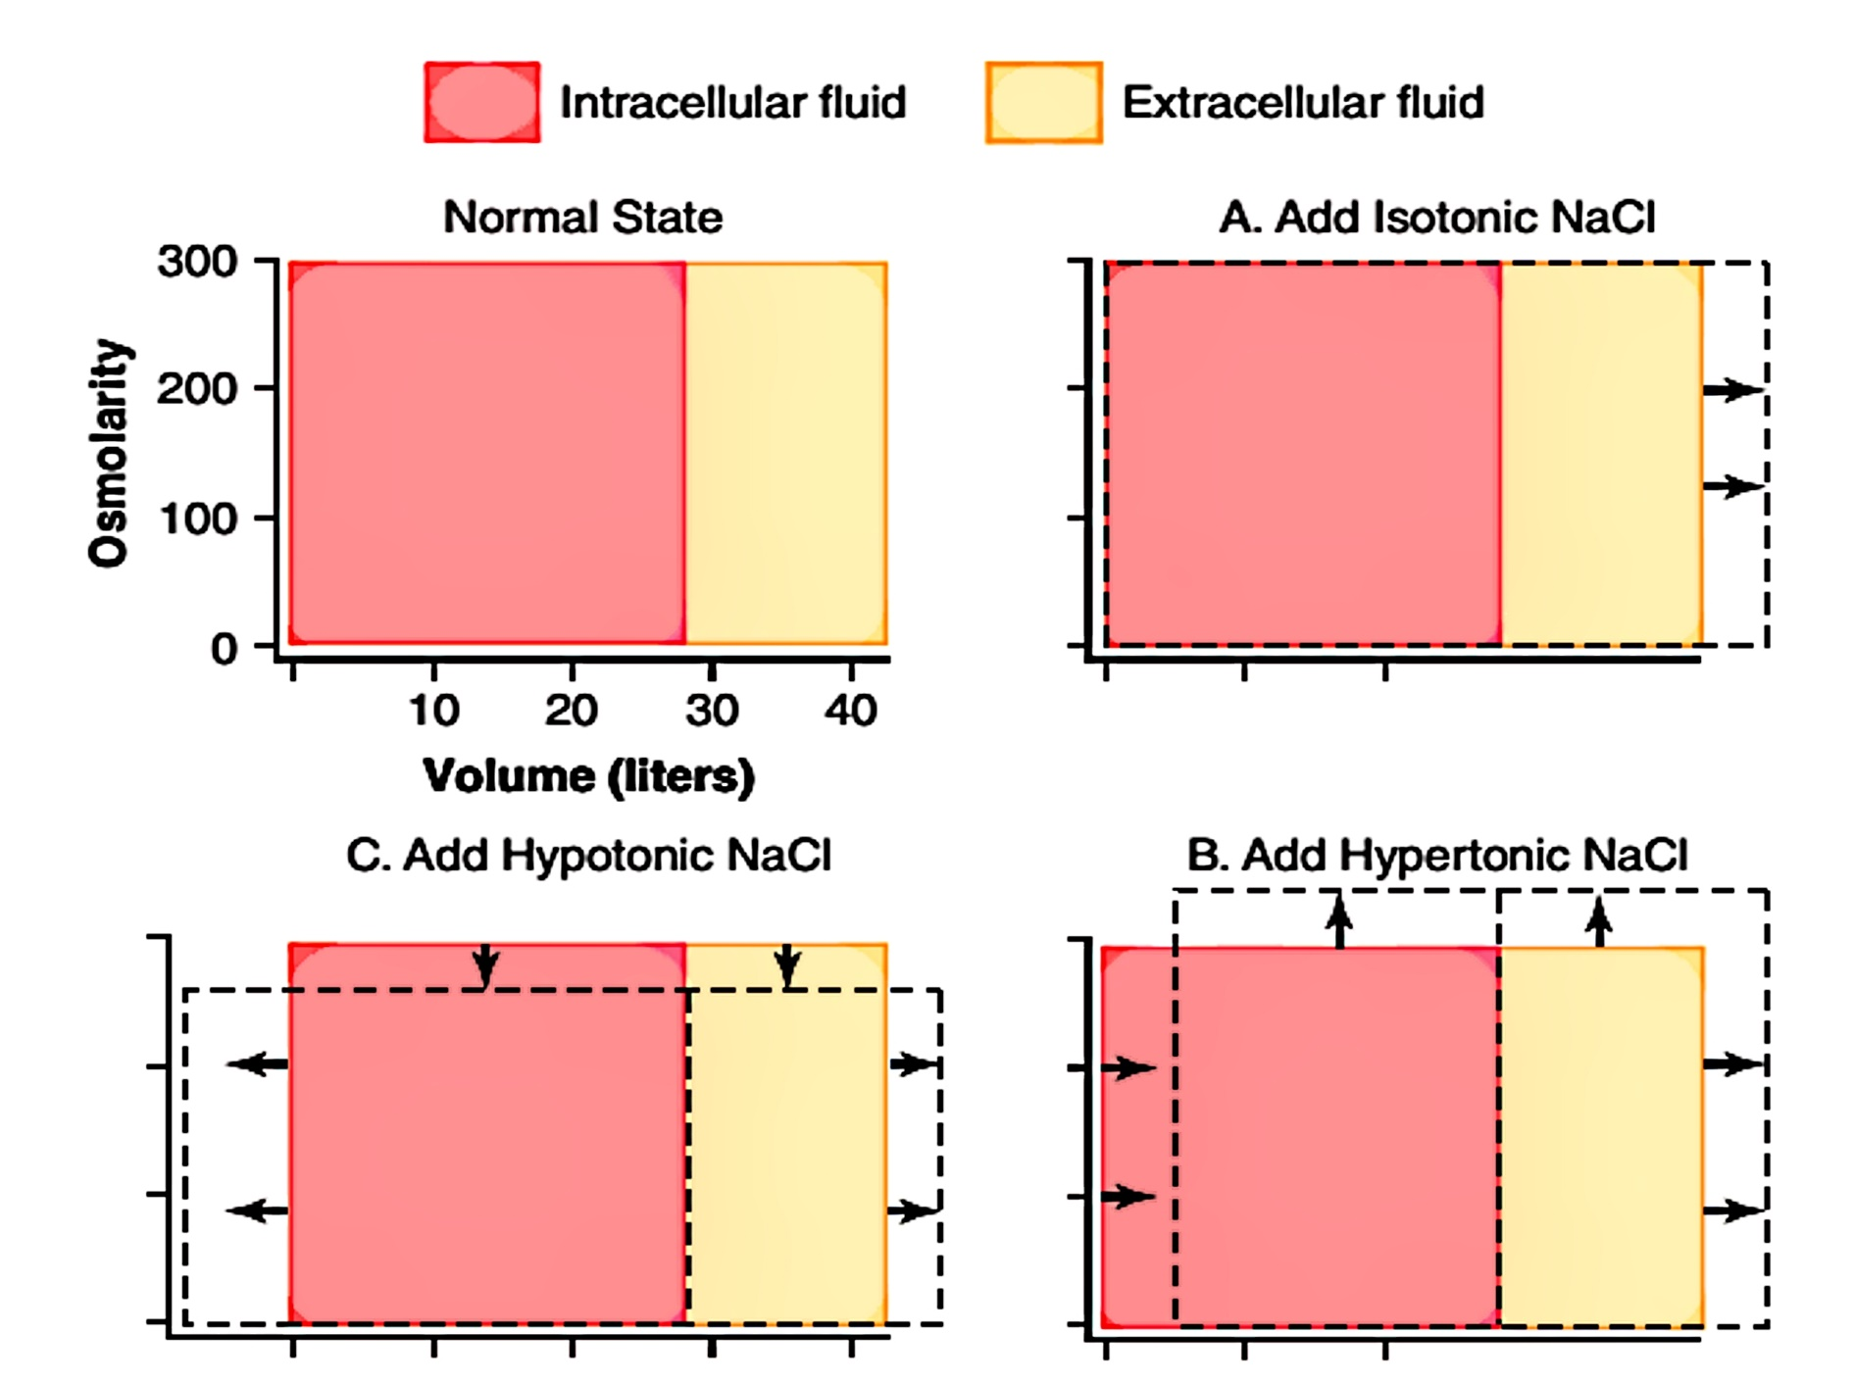
Effect of adding isotonic, hypertonic, and hypotonic solutions to the extracellular fluid after osmotic equilibrium. The normal state is indicated by the solid lines, and the shifts from normal are shown by the shaded areas.

Slide 16
CONSEQUENCES OF HYPONATREMIA: CELL SWELLING
A rapid reduction in plasma sodium concentration, for example, can cause brain cell edema and neurological symptoms, including headache, nausea, lethargy, and disorientation
If plasma sodium concentration rapidly falls below 115 to 120 mmol/L, brain swelling may lead to seizures, coma, permanent brain damage, and death
the skull is rigid, the brain cannot increase its volume by more than about 10 percent without it being forced down the neck (herniation), which can lead to permanent brain injury and death

Slide 17
Brain cell volume regulation during hyponatremia
swelling of the brain tissue stimulates transport of Na⁺, K⁺, and organic solutes out of the cell
Due to loss of Na⁺ or excess H₂O, there is diffusion of H₂O into the cells
water diffusion out of the cells

Slide 18
When hypertonic solutions are added too rapidly to correct hyponatremia, this can outpace the brain’s ability to recapture the solutes lost from the cells and may lead to osmotic injury of the neurons that is associated with demyelination
This osmotic-mediated demyelination of neurons can be avoided by limiting the correction of chronic hyponatremia to less than 10 to 12 mmol/L in 24 hours and to less than 18 mmol/L in 48 hours
Hyponatremia is the most common electrolyte disorder encountered in clinical practice and may occur in upto 15% to 25% of hospitalized patients

Slide 19
CONSEQUENCES OF HYPERNATREMIA: CELL SHRINKAGE
Hypernatremia is much less common than hyponatremia and severe symptoms usually occur only with rapid and large increases in plasma sodium concentration above 158 to 160 mmol/L. One reason for this is that hypernatremia promotes intense thirst that protects against a large increase in plasma and extracellular fluid sodium
Correction of hypernatremia can be achieved by administering hypo-osmotic sodium chloride or dextrose solutions
It is prudent to correct the hypernatremia slowly in patients who have had chronic increases in plasma sodium concentration

Slide 20
EDEMA: Excess Fluid in the Tissues
Edema refers to the presence of excess fluid in the body tissues. In most instances, edema occurs mainly in the extracellular fluid compartment, but it can involve intracellular fluid as well.

Slide 21
INTRACELLULAR EDEMA
Three conditions are especially prone to cause intracellular swelling:
hyponatremia,
depression of the metabolic systems of the tissues; and
lack of adequate nutrition to the cells
Intracellular edema can also occur in inflamed tissues. Inflammation usually increases cell membrane permeability, allowing sodium and other ions to diffuse into the interior of the cell, with subsequent osmosis of water into the cells

Slide 22
EXTRACELLULAR EDEMA
two general causes of extracellular edema:
Abnormal leakage of fluid from the plasma to the interstitial spaces across the capillaries, and
Failure of the lymphatics to return fluid from the interstitium back into the blood, often called lymphedema

Slide 23
Filtration = K_{f} × (P_{c} − P_{if} − π_{c} + π_{if})
Where, K_{f} is the capillary filtration coefficient (the product of the permeability and surface area of the capillaries),
P_{c} is the capillary hydrostatic pressure,
P_{if} is the interstitial fluid hydrostatic pressure,
π_{c} is the capillary plasma colloid osmotic pressure, and
π_{if} is the interstitial fluid colloid osmotic pressure
From this equation, one can see that any one of the following changes can increase the capillary filtration rate:
• Increased capillary filtration coefficient
• Increased capillary hydrostatic pressure
• Decreased plasma colloid osmotic pressure

Slide 24
SUMMARY OF CAUSES OF EXTRACELLULAR EDEMA

Slide 25
I. Increased capillary pressure
A. Excessive kidney retention of salt and water 1. Acute or chronic kidney failure 2. Mineralocorticoid excess
B. High venous pressure and venous constriction 1. Heart failure 2. Venous obstruction 3. Failure of venous pumps (a) Paralysis of muscles (b) Immobilization of parts of the body (c) Failure of venous valves
C. Decreased arteriolar resistance 1. Excessive body heat 2. Insufficiency of sympathetic nervous system 3. Vasodilator drugs

Slide 26
II. Decreased plasma proteins
A. Loss of proteins in urine (nephrotic syndrome)
B. Loss of protein from denuded skin areas
1. Burns
2. Wounds
C. Failure to produce proteins
1. Liver disease (e.g., cirrhosis)
2. Serious protein or caloric malnutrition

Slide 27
III. Increased capillary permeability
A. Immune reactions that cause release of histamine and other immune products
B. Toxins
C. Bacterial infections
D. Vitamin deficiency, especially vitamin C
E. Prolonged ischemia
F. Burns
IV. Blockage of lymph return
A. Cancer
B. Infections (e.g., filaria nematodes)
C. Surgery
D. Congenital absence or abnormality of lymphatic vessels

Slide 28
Safety Factors That Normally Prevent Edema
The safety factor caused by low compliance of the interstitium when interstitial fluid pressure is in the negative pressure range is about 3 mm Hg
The safety factor caused by the ability of lymph flow to increase 10- to 50 fold is about 7 mm Hg
The safety factor caused by the washdown of proteins from the interstitial spaces (which reduces interstitial fluid colloid osmotic pressure as capillary filtration increases) is about 7 mm Hg
Therefore, the total safety factor against edema is about 17 mm Hg. This means that the capillary pressure in a peripheral tissue could theoretically rise by 17 mm Hg, or approximately double the normal value, before marked edema would occur

Slide 29
Low Compliance of the Interstitium in the Negative Pressure Range
Interstitial fluid hydrostatic pressure in most loose subcutaneous tissues of the body is slightly less than atmospheric pressure, averaging about −3mm Hg. This slight suction in the tissues helps hold the tissues together.
Because the normal interstitial fluid hydrostatic pressure is −3 mm Hg, the interstitial fluid hydrostatic pressure must increase by about 3 mm Hg before large amounts of fluid will begin to accumulate in the tissues. Therefore, the safety factor against edema is a change of interstitial fluid pressure of about 3 mm Hg

Slide 30
In normal tissues with negative interstitial fluid pressure, virtually all the fluid in the interstitium is in gel form. That is, the fluid is bound in a proteoglycan meshwork so that there are virtually no “free” fluid spaces larger than a few hundredths of a micrometer in diameter.
When interstitial fluid pressure rises to the positive pressure range, there is a tremendous accumulation of free fluid in the tissues. When this occurs, the edema is said to be pitting edema because one can press the thumb against the tissue area and push the fluid out of the area.
Non-pitting edema occurs when the tissue cells swell instead of the interstitium or when the fluid in the interstitium becomes clotted with fibrinogen so that it cannot move freely within the tissue spaces.

Slide 31
EFFUSION
When edema occurs in the subcutaneous tissues adjacent to the potential space, edema fluid usually collects in the potential space as well and this fluid is called effusion
Some examples of “potential spaces” are pleural cavity, pericardial cavity, peritoneal cavity, and synovial cavities, including both the joint cavities and the bursae
The abdominal cavity is especially prone to collect effusion fluid, and in this instance, the effusion is called ascites

Slide 32
Q1. In a normal adult female, the total body fluid
is___% of body weight:
40%
50%
60%
70%

Slide 33
Q2. Approximate insensible water loss through skin is:
A) 350 ml/hr.
B) 700 ml/hr.
C) 350 ml/day
D) 700 ml/day

Slide 34
Q3. In a 70kg. Adult man, intracellular fluid is approximately:
3L
11L
14L
28L

Slide 35
Q4. The osmolarity of intracellular fluid is mainly due to :
K⁺
Na⁺
Cl⁻
HCO₃⁻

Slide 36
Q5. Intravascular fluid can be measured by:
A) evans blue dye
B) thiosulphate
C) inulin
D) none of the above

Slide 37
Q6. A solution containing 0.5 moles of KCl (potassium chloride) per litre, has osmolar concentration ___:
0.25 osm/L
0.5 osm/L
1.0 osm/L
2 osm/L

Slide 38
Q7. Osmolality is:
Osmoles / kilogram of solution
Osmoles / litre of solution
Osmoles / kilogram of solvent
Osmoles / litre of solvent

Slide 39
Q8. Following can cause intracellular edema:
Abnormal leakage of fluid from the plasma to the interstitial spaces across the capillaries
Failure of the lymphatics to return fluid from the interstitium back into the blood
Depression of the metabolic systems of the tissues
ALL of the above

Slide 40
Q9. Factors preventing edema are:
Low compliance of the interstitium in negative pressure range
Increased lymph flow
Washdown of proteins from the interstitial spaces
All of the above

Slide 41
Q10. non-pitting edema occurs when:
the tissue cells swell instead of the interstitium
when the fluid in the interstitium becomes clotted with fibrinogen
Both A and B
None

